Slide 1
smartGuard
Santiago Alzate and Wilson Bridges

Slide 2

Idea..
The idea was to create a smart doorbell with Google Assist & Facial Recognition
Text Messaging Alert
Low Cost
Easy to use
Accessible everywhere thru WiFi

Slide 3
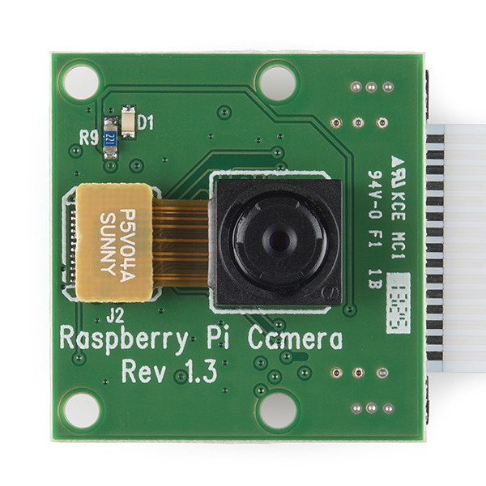
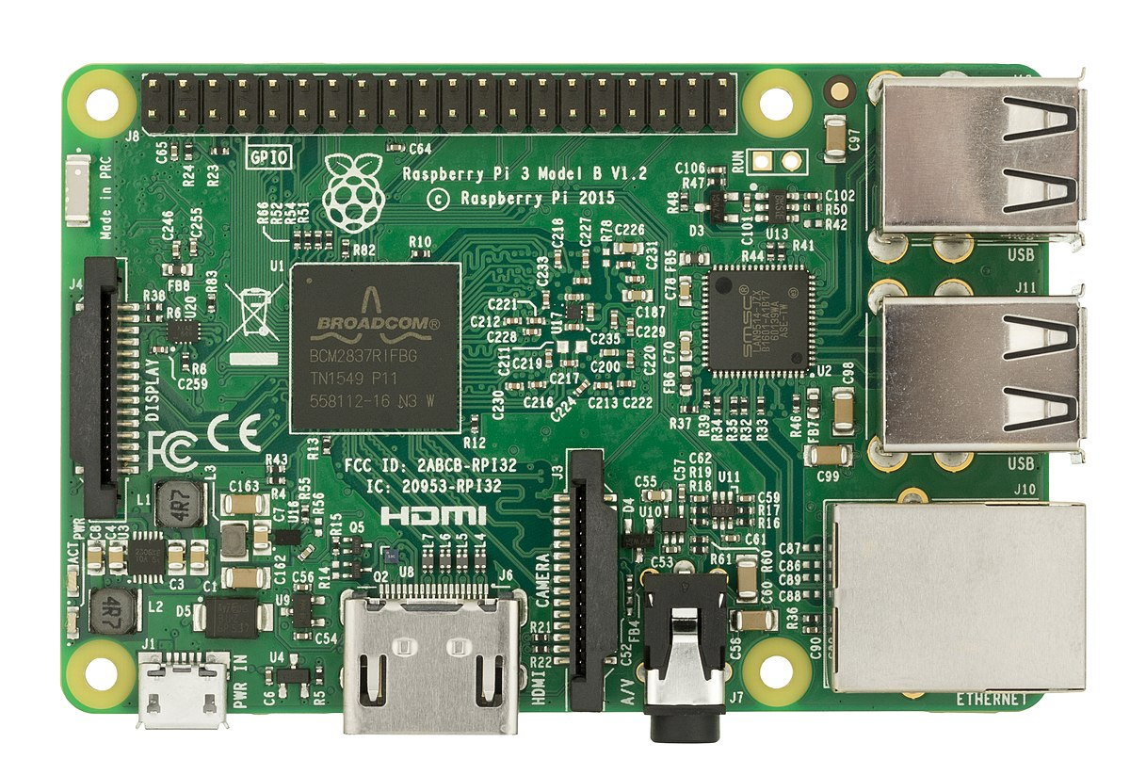
The Parts
Raspberry Pi 3
Raspberry Pi Camera

Slide 4
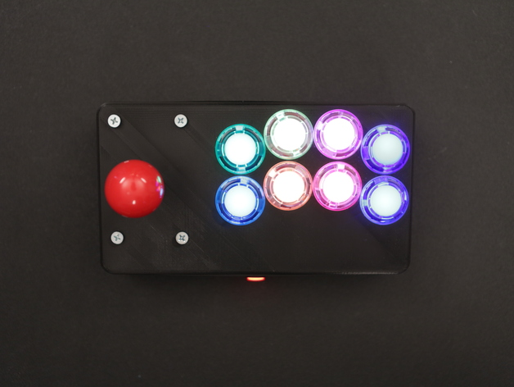

Parts.. Continued
Speaker
Button LED

Slide 5

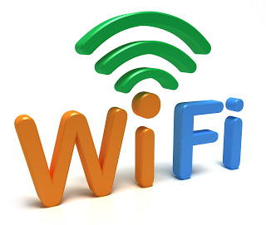
Connection
WiFi
TCP/IP

Slide 6
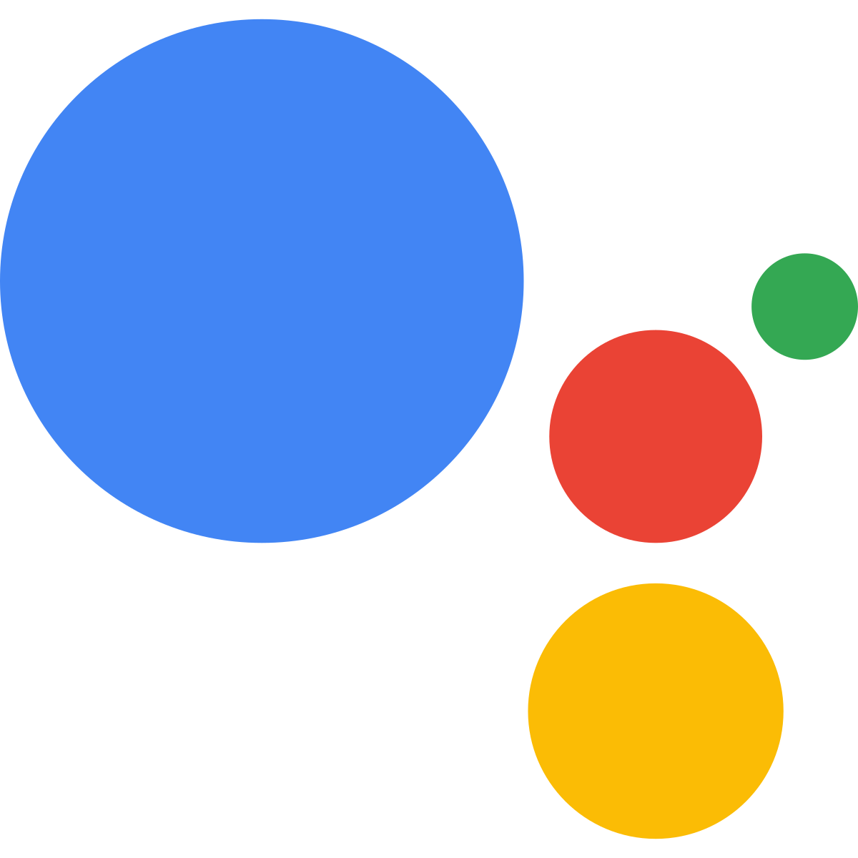
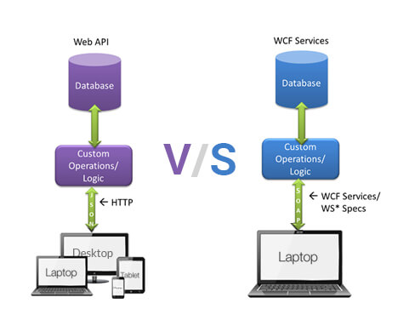
Services
Google Assist
Twilio API

Slide 7
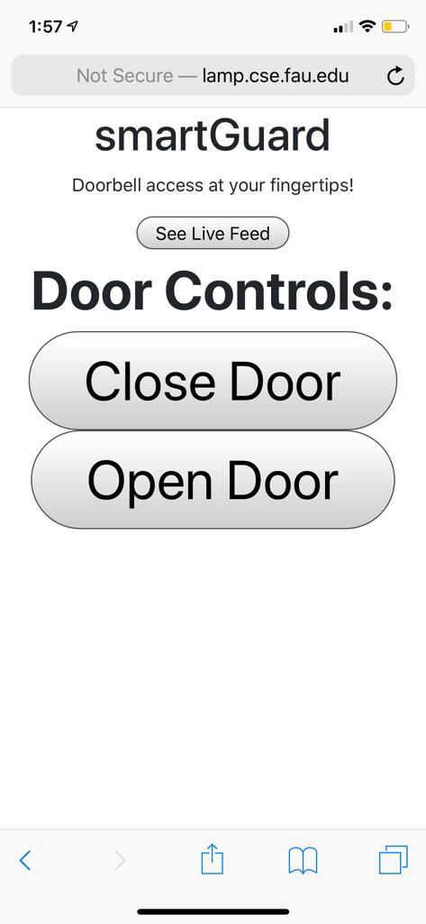
Interface

Slide 8
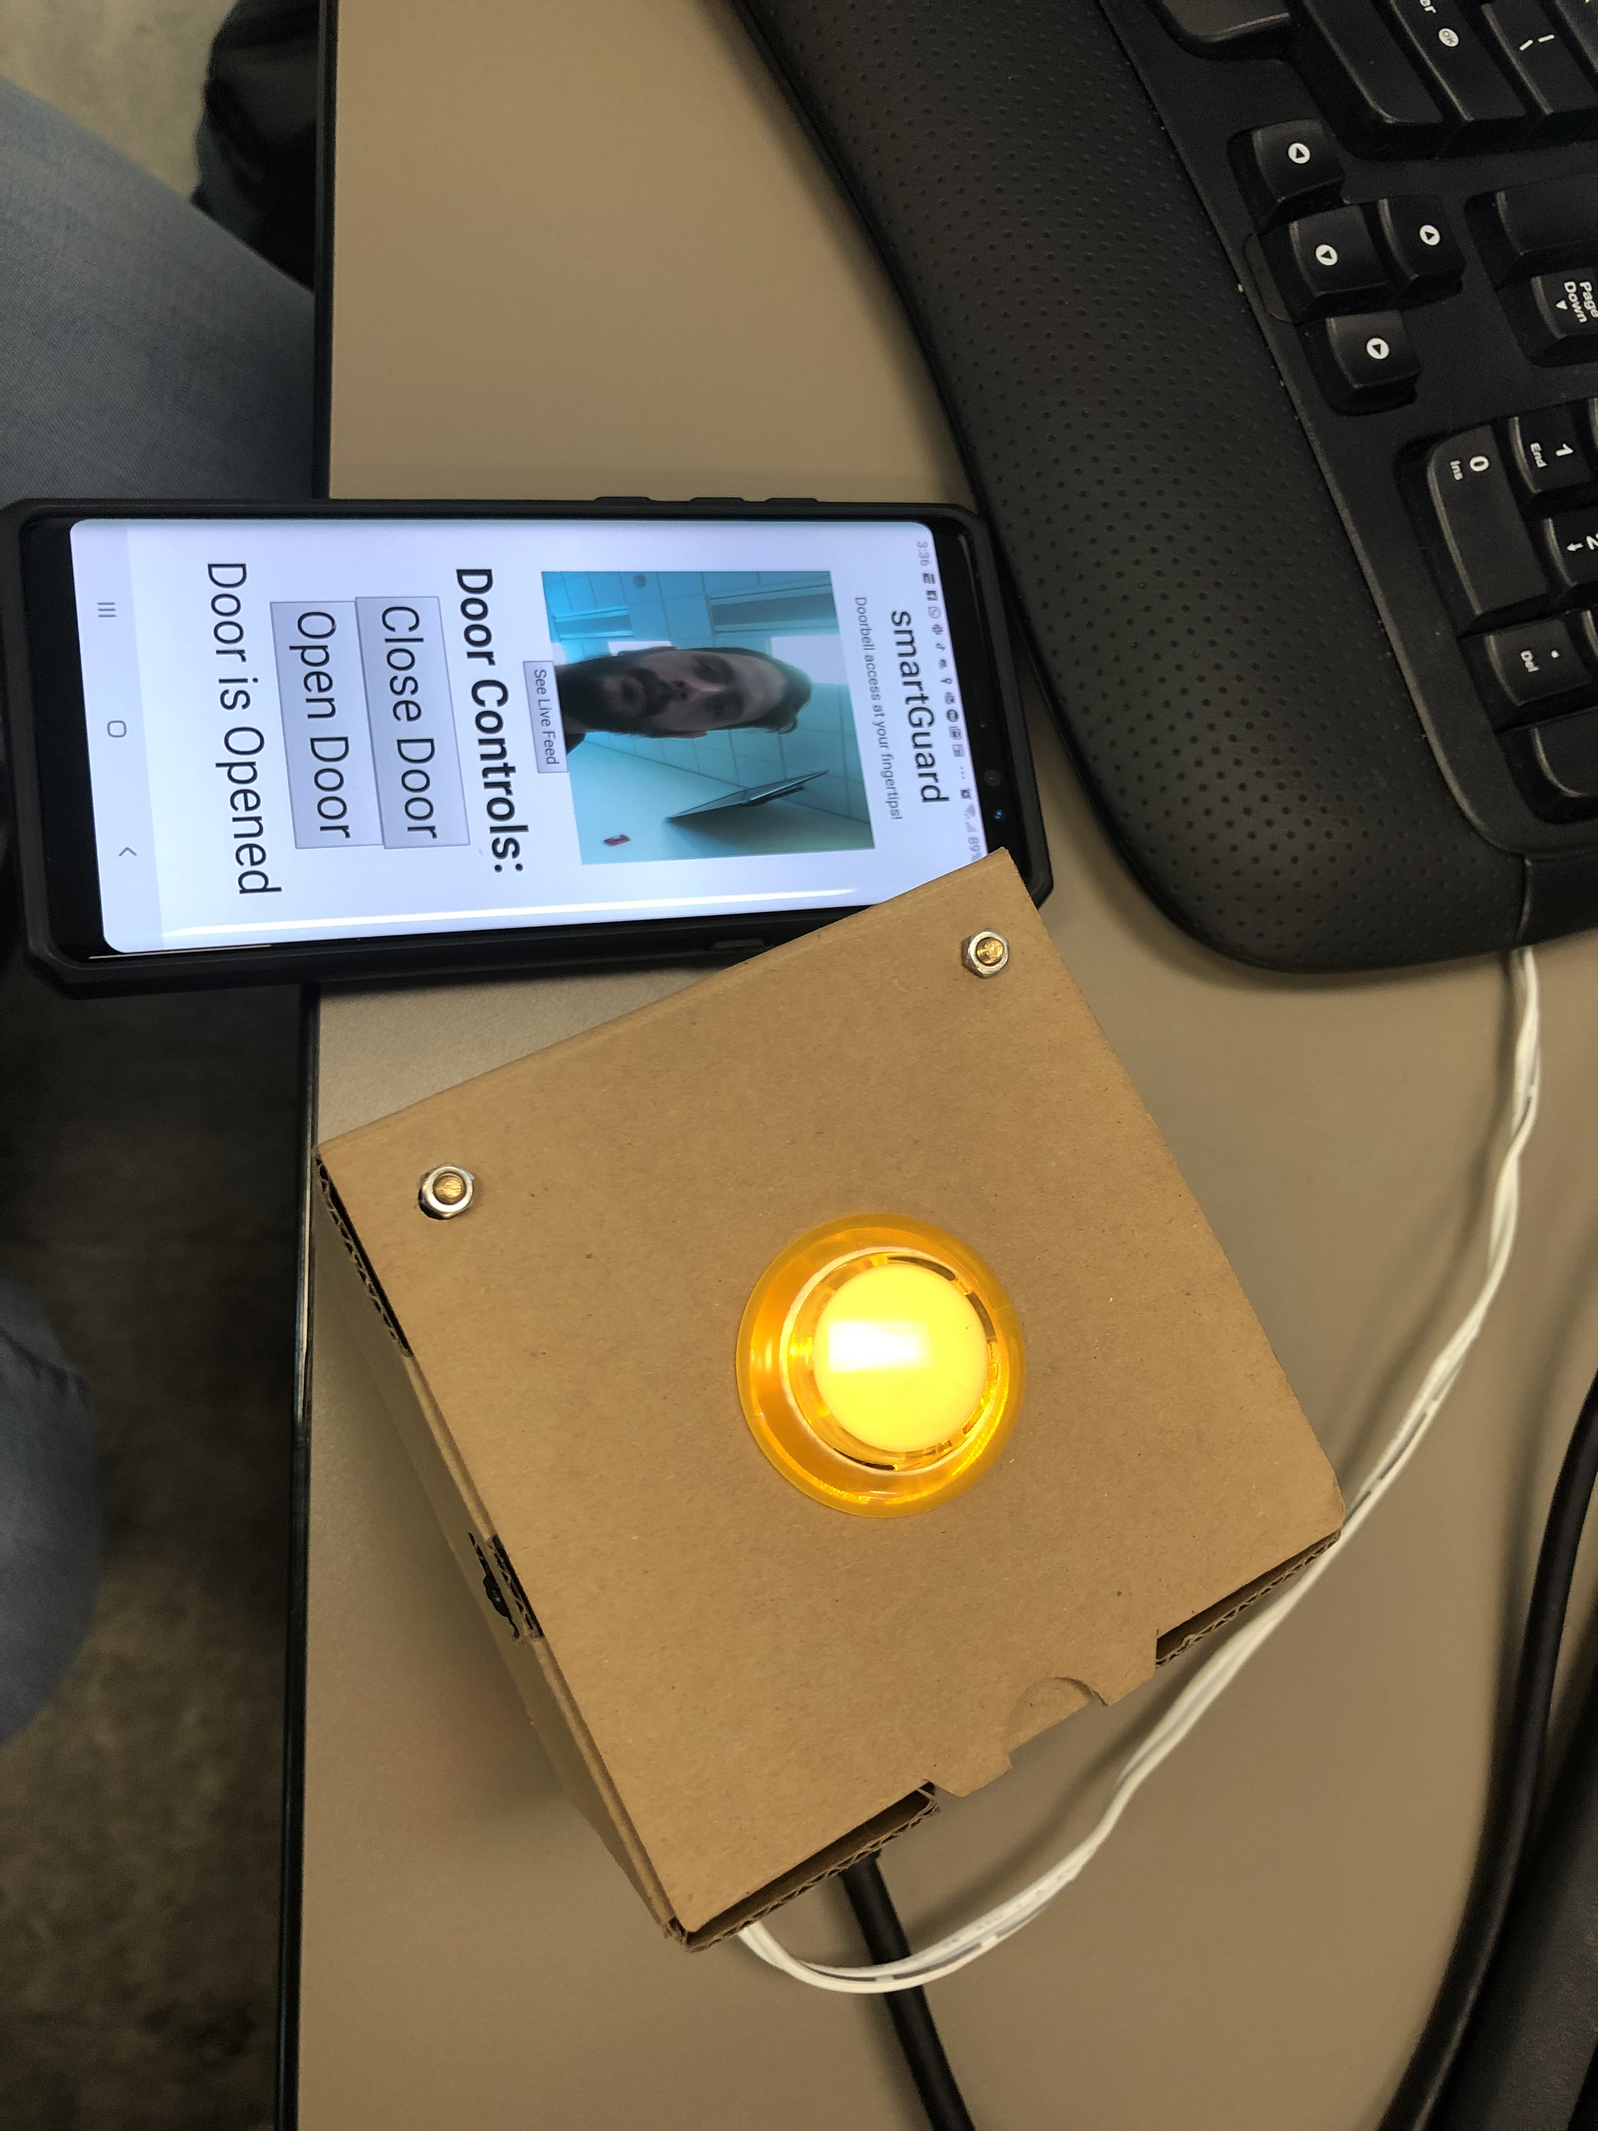
Final Product

